Slide 1
Real-time Volumetric Fog Simulation
Milestone Presentation
Lucia Tódová
25.04.2020

Slide 2
Done so far
Original steps and goals:
Modeling (noise generation)
Visualization (ray marching)
Lighting (emission, absorption, scattering)
Optimization
Implementation of Worley and Perlin noise
Ray marching
Part of light marching
Unity GUI Inspector

Slide 3
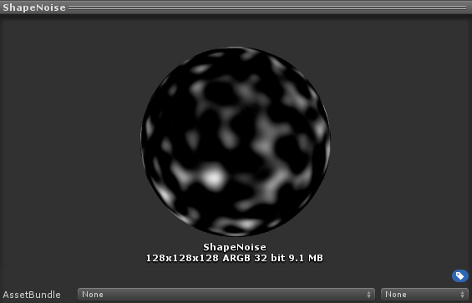
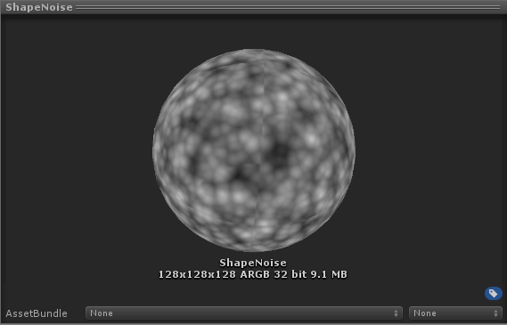
Noise Generation
Perlin Noise
Worley and Perlin noise functions
Possibility of multiple octaves (Fractal Brownian noise)
Setbacks:
Compute shader implementation and dispatching
Unity's RenderTexture and Texture3D classes and their conversion
Complicated testing in 3D
Tiling of the noises
Inverted Worley Noise

Slide 4
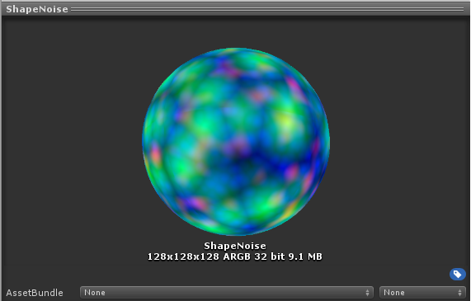
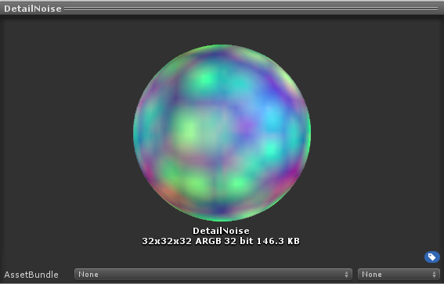
Noise Textures for Cloud Rendering
Shape Texture
Detail Texture
128 x 128 x 128 resolution
Red channel – Perlin noise
Other channels – Worley noise
Density: R * (B + G + A)
32 x 32 x 32 resolution
Alpha channel – 1 (max value)
Other channels – Worley noise
Density: (B + G + R)/4

Slide 5
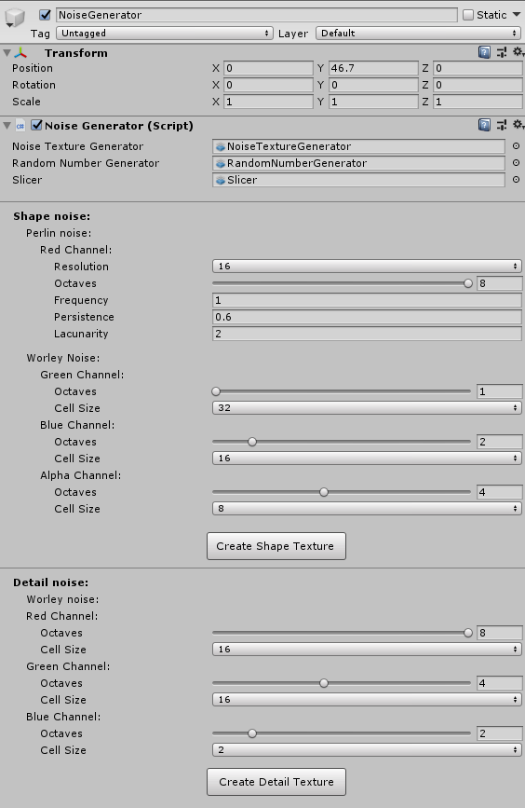
Noise Generator Script
Custom editor
Shape and Detail noise independent of each other
Saves the textures to the Resources folder
Advice for creating textures:
Use varying octaves of Worley noise
Ideal cell size for Worley is 8/16

Slide 6
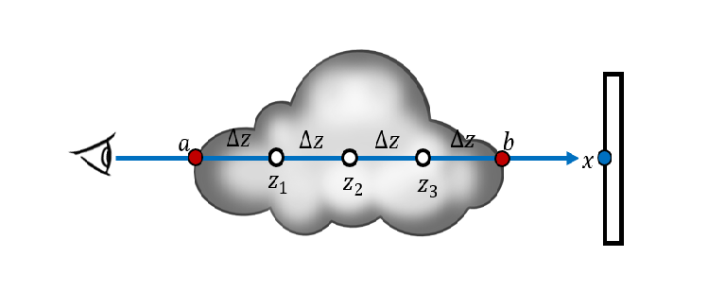
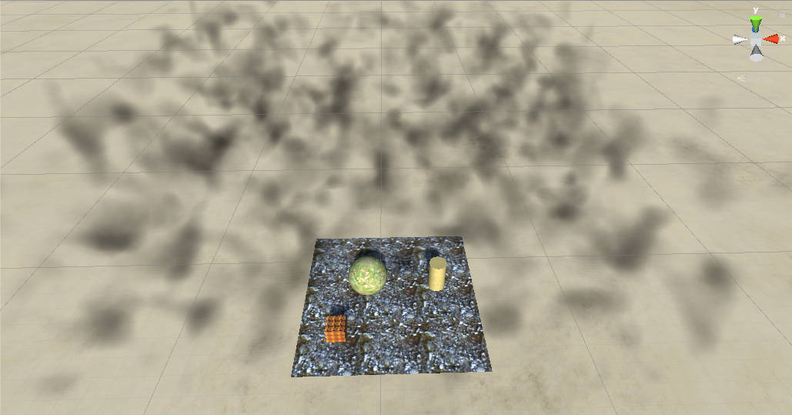
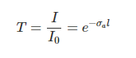
Ray marching
March along a ray from A to B
At each point, compute the density
Sum densities up to get the density of point A
Density computation:
Shape Texture Density – Detail Texture Density
Weight of the point along a ray determined by Beer's Law
delta Z = step size; z1, z2, z3 – points of evaluation
Transmittance at point dependent on absorption coefficient and current distance

Slide 7
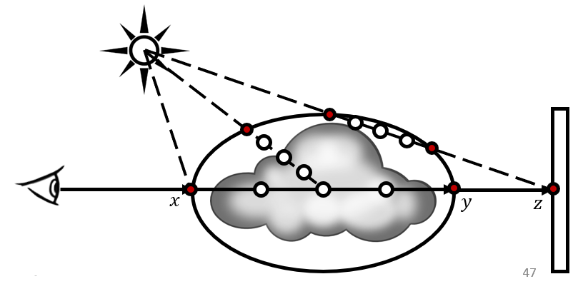
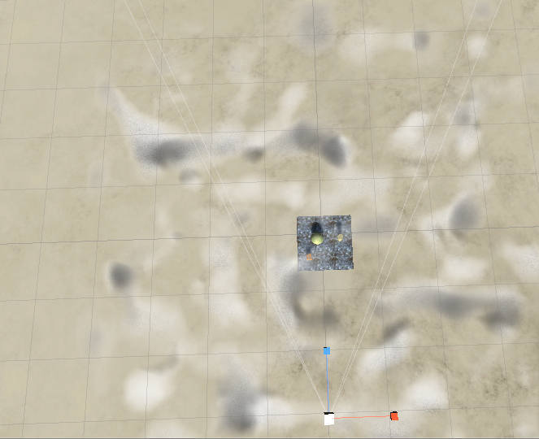
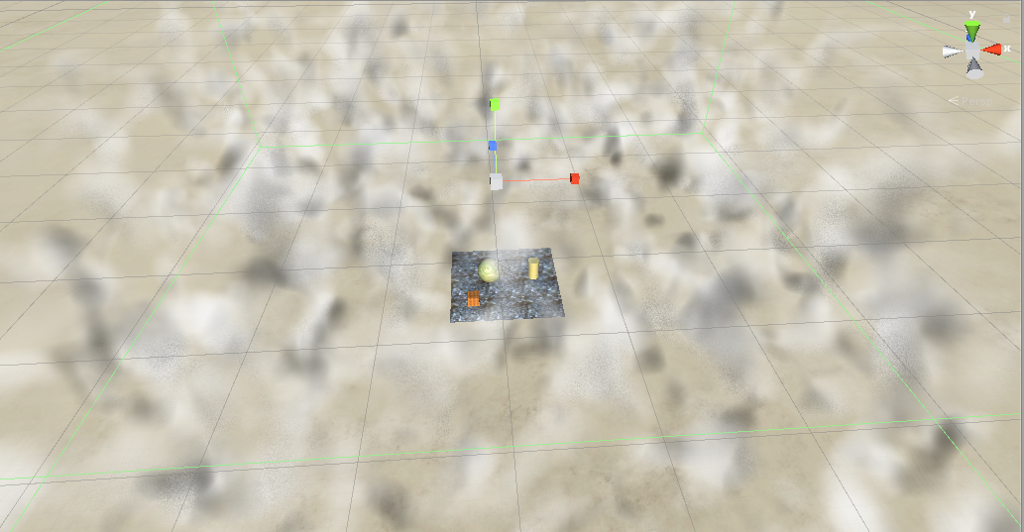
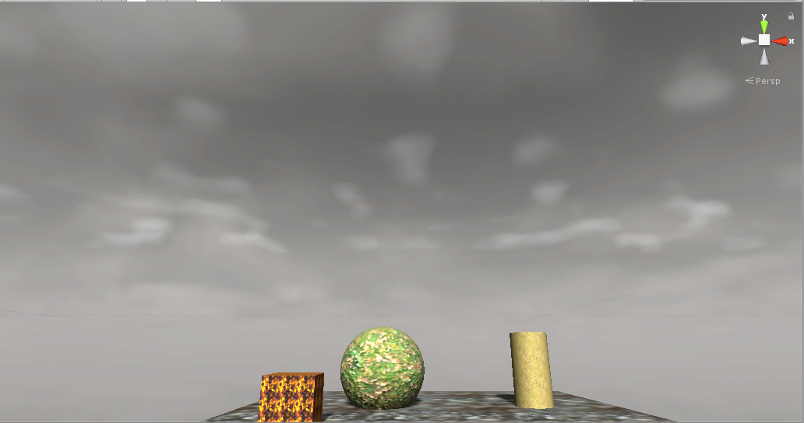
Light marching
In progress
Compute incident light at each point during ray march
Ray march towards the light source
Multiply the current density with total light

Slide 8
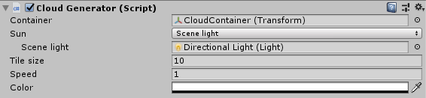
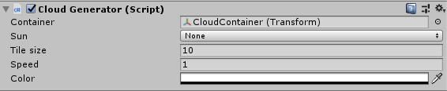
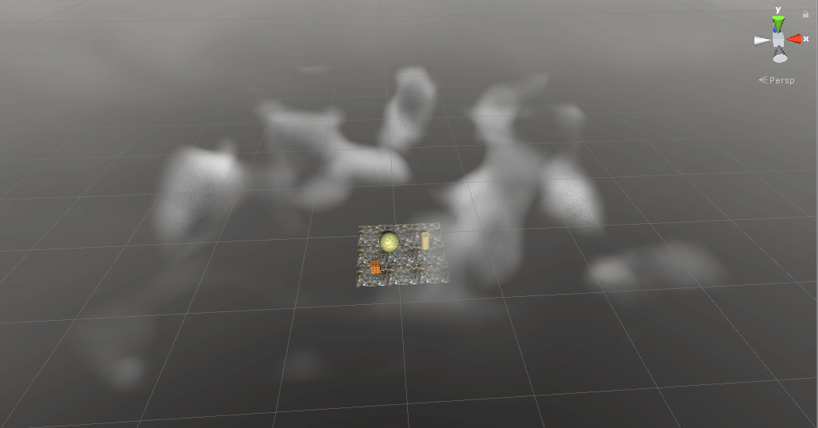
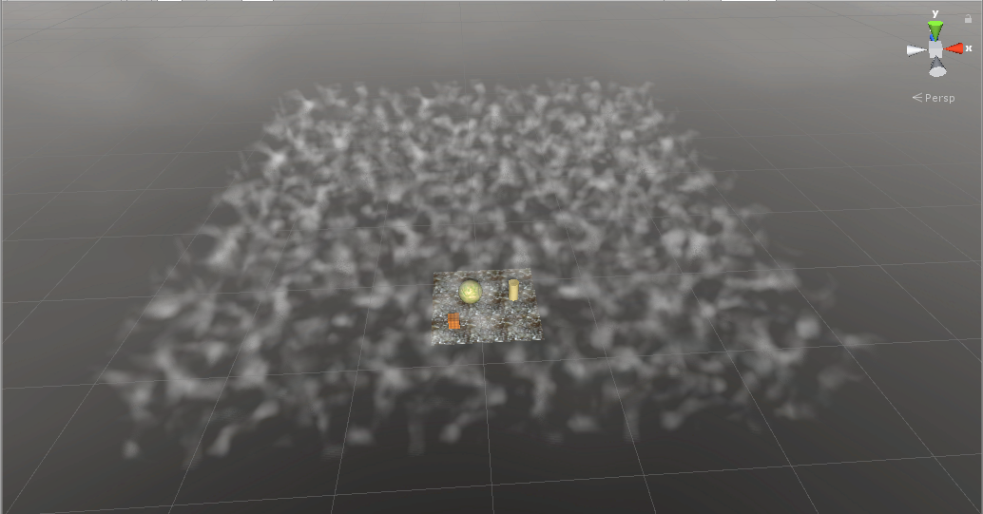
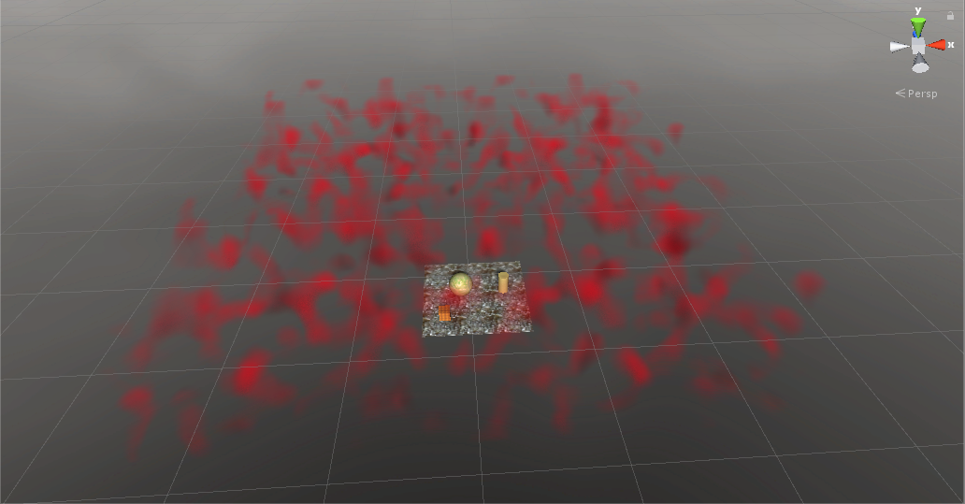
Cloud Generator Script
In progress
Option for choosing which light is used for light march
Only one light to avoid performance problems
Tile Size: 2
Tile Size: 10
Color: Red
Note: Color is not attenuated

Slide 9
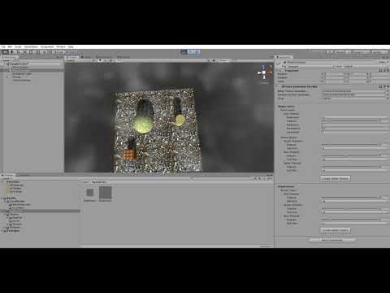

Slide 10
Nice to have:
Future work:
Complete the incident light calculations
Optimizations for Oculus Quest
Find optimal ray marching step size
Scene light color and intensity dependent illumination
Weather map
Cloud density dependent on height
Random number generation in Compute Shader
Directional Light support
User adjustable wind direction
Better density calculations
Remap function

Slide 11
Thank you for your attention!
Lucia Tódová
25.04.2020

